Slide 1
Climate Change Prediction Using Artificial Neural Network (ANN)
This project aims to assess and predict the impact of climate change by comparing historical and recent weather forecasts using an Artificial Neural Network (ANN) model. The project involves using weather data from multiple airports to analyze trends in climate variables and project potential changes.
BY-RONIT SINGH 500107871
DAYA SINGH 500107846
Notes:
1

Slide 2
Dataset Description
Source
Variables
The data comes from several airport meteorological stations. These datasets are expected to provide high-accuracy local weather conditions.
Air Temperature
Humidity
Liquid Precipitation
Snow Depth
Horizontal Visibility
Wind Direction
Wind Speed
Notes:
2

Slide 3
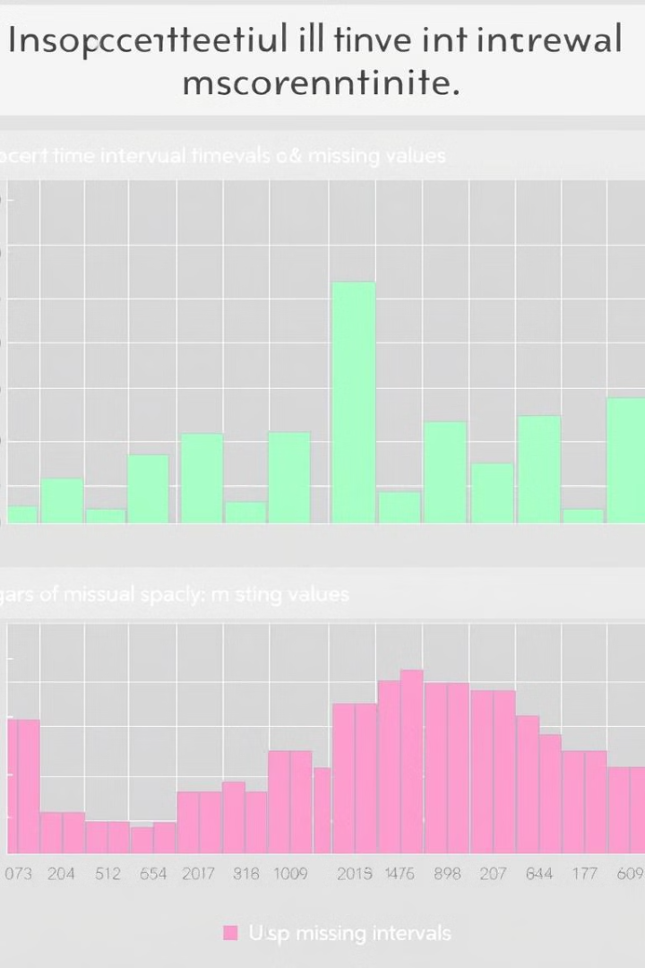

Challenges with Datasets
1
Inconsistent Time Intervals
2
Missing Values
Certain weather features may have gaps, requiring careful handling to avoid bias.
Data from different airports may have varied time intervals (hourly, daily, or monthly).
3
Data Standardization
Differences in measurement units or formats necessitated preprocessing to standardize values for accurate predictions.
Notes:
3

Slide 4
Data Preprocessing
1
Handling Missing Values
Missing data was managed using interpolation techniques to fill gaps and ensure continuous time series data across all variables.
2
Time Interval Alignment
Given that each airport’s dataset may use different intervals, resampling was performed to standardize data to a common frequency.
3
Data Normalization
Data normalization was applied using MinMax scaling. This transformation process scaled each feature within the range \[0, 1\], facilitating more stable and accurate ANN training.
4
Feature Engineering
Seasonal and temporal features (e.g., month, day) were added to capture seasonal trends and cyclic weather patterns.
Notes:
4

Slide 5
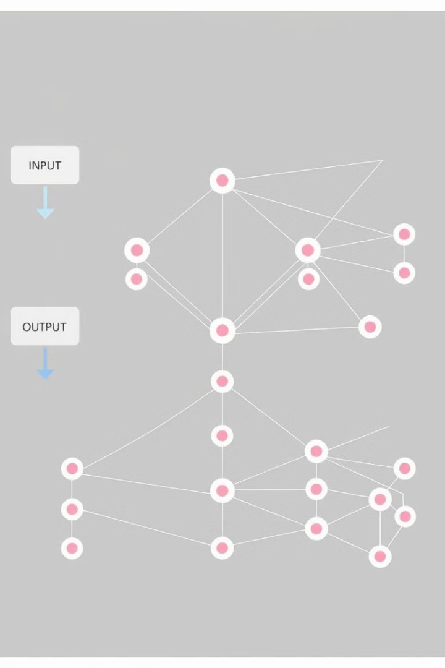
Model Architecture
Layer
Description
Input Layer
7 nodes, one for each weather variable (temperature, humidity, etc.).
Hidden Layers
Three dense layers, each containing 64, 128, and 64 neurons, respectively, using ReLU (Rectified Linear Unit) as the activation function to introduce non-linearity.
Output Layer
The output layer includes seven nodes corresponding to the seven weather variables, allowing for simultaneous prediction of all features.
Notes:
5

Slide 6




Model Training and Evaluation
Training Configuration
Evaluation Metrics
Validation and Cross-Validation
The model was trained over 100 epochs with a batch size of 32, ensuring a balance between speed and learning efficiency.
Mean Squared Error (MSE) and Root Mean Squared Error (RMSE) provided insights into the accuracy of each predicted weather variable.
Cross-validation was performed by dividing the data into training and validation sets across multiple folds to ensure robustness.
Notes:
6

Slide 7
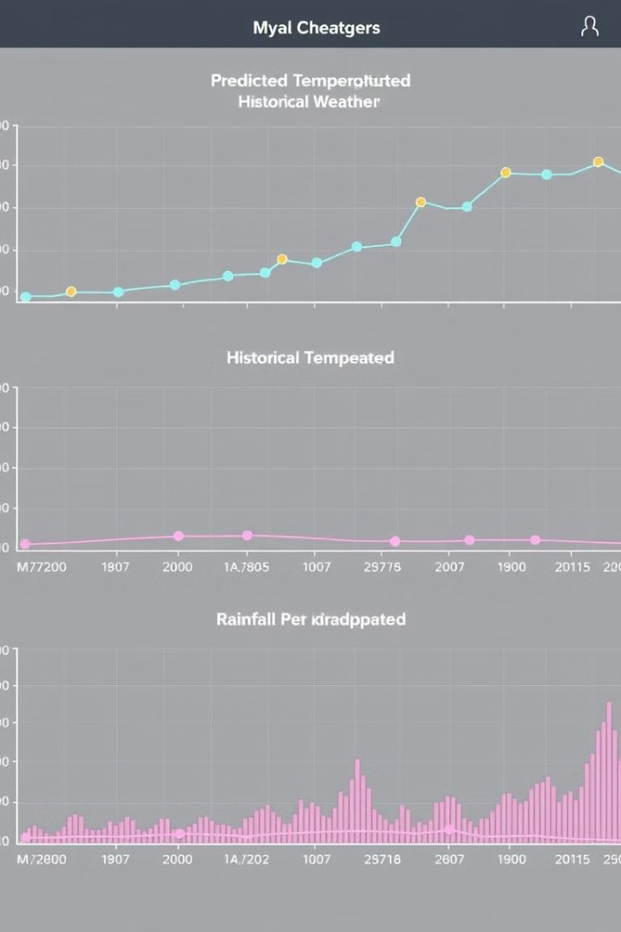
Results and Analysis
Prediction Accuracy
Climate Change Detection
The model achieved satisfactory MSE and RMSE scores across most weather variables, indicating that it successfully learned the patterns in historical weather data.
By comparing predictions with historical weather patterns, trends in temperature, precipitation, and other variables showed significant deviations, suggesting possible signs of climate change.
Notes:
7

Slide 8




Conclusion
Summary
Model Strengths
The ANN-based weather prediction model successfully identified key indicators of climate change, capturing trends across multiple weather variables using historical and recent data from various airport meteorological stations.
Ability to predict multiple weather variables simultaneously. Adaptability to various weather datasets with inconsistent time intervals.
Limitations and Future Work
Future Work
Time Interval Inconsistencies: Although resampling was applied, variations in data intervals still present limitations.
Feature Expansion: Additional features such as solar radiation, pressure, and advanced seasonal indicators could enhance predictive accuracy.
Notes:
8

